Slide 1
Eye tracking and low vision
Visual Attention and Cognition Lab
Capstone project
By Zhengchen Zhou& Mary Nichols
Aug 2022-Dec 2022
Notes:
M

Slide 2
Outline
Throughout: how you communicate and collaborate
Background_ context, problem, research goal
Challenges
Any budget or timeline constraints?
What method? Why this method?
Three top findings
Impact
(Bonus) Your learnings_ introspect
Notes:
M

Slide 3
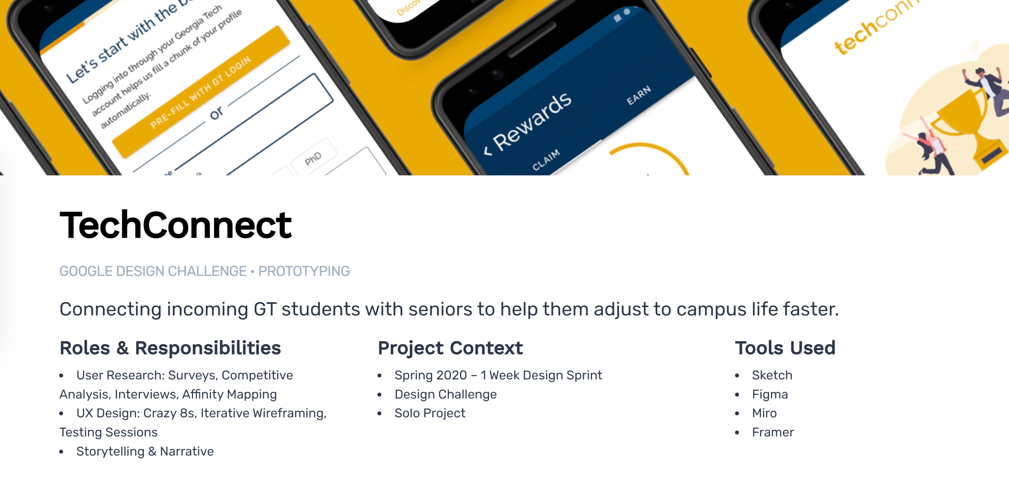
Notes:
M : Theofanos & Redish’s findings

Slide 4
report
https://drive.google.com/file/d/1pdcU9K72oLJ6gxpcuMCwL2lrTtNNEvaG/view
https://drive.google.com/file/d/1eCaBz-PEsHf_BT9y5ew10htIYgEQJXwj/view
https://drive.google.com/file/d/1wuv6oBVD1a1TvqTLfXAZbAQW1cG1KU1J/view

Slide 5
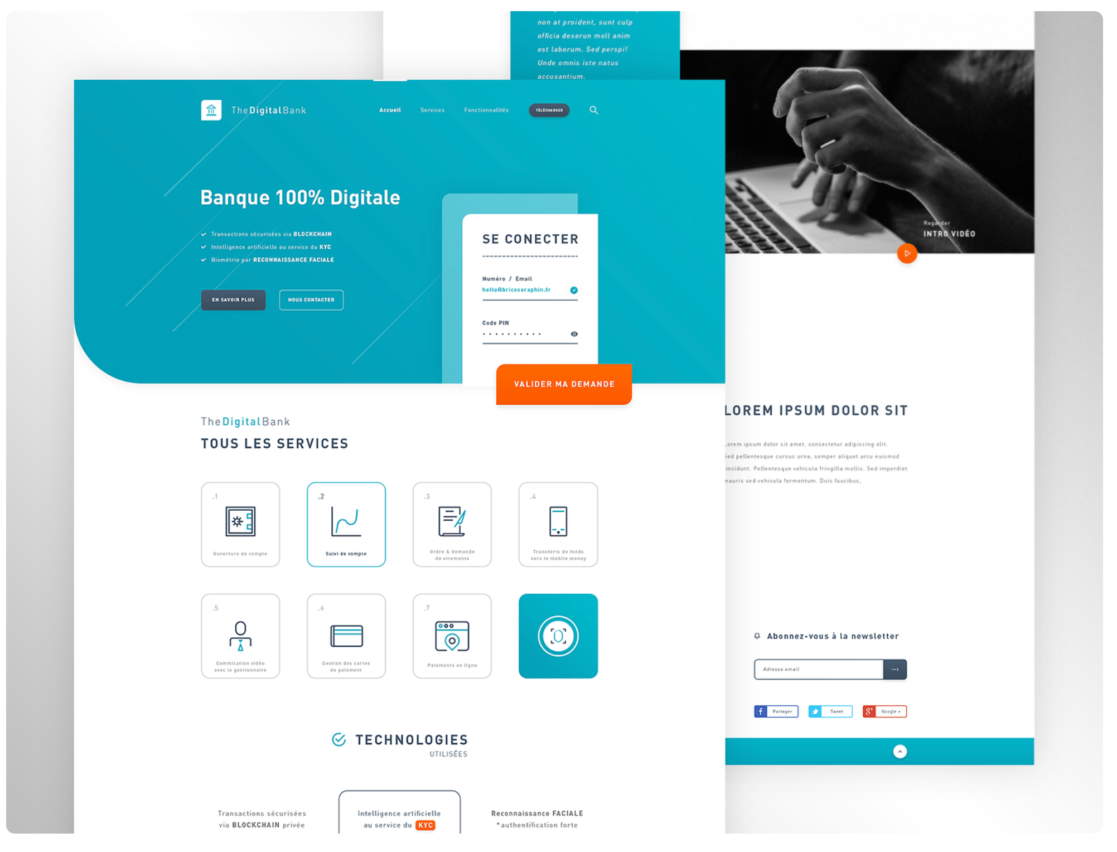
Banner
1 accessible hotmap
1 inaccessible one

Slide 6
The problem
If a website is created based off accessibility principles, is costly assistive technology necessary?
Notes:
M : Theofanos & Redish’s findings

Slide 7
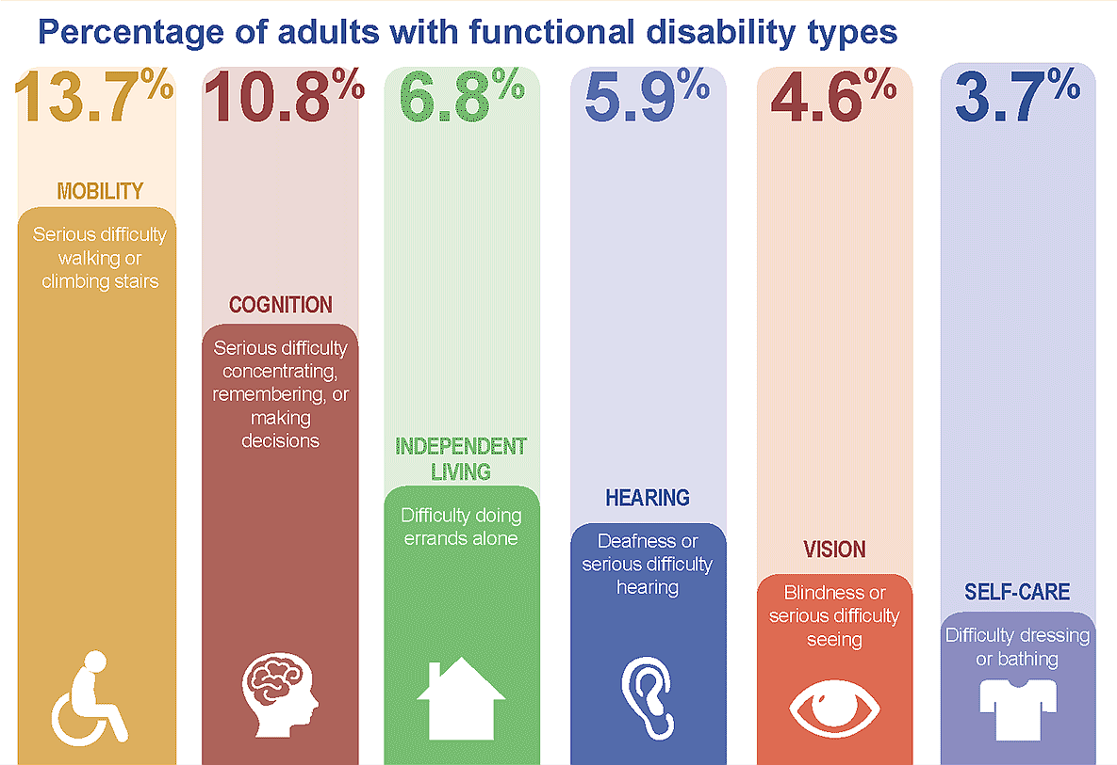
Background
1 in 8 Americans has a disability for 5+ years
Low vision = 4.3 million
Top ten of disabilities in the U.S.
Notes:
Demographics first
One in eight American workers will be disabled for 5 or more years during their working careers
CDC, 2020
Which stands among 10…

Slide 8
Low vision stats. Refer mary
217 million people globally are visually impaired
Low vision is caused by
  Macular degeneration
  Cataracts
  Glaucoma
  Other chronic conditions
In 2014, the number of people with cataracts was 25 million
Impact:
15% of U.S. adults with a disability do not use the internet
Compared to 5% of abled U.S. adults who do not use the internet
Notes:
Z:
moderate to severe vision loss, (corrective eyewear
Hard to integrate
Some of the factors-cause global vision loss, some cause peripheral visionloss-
In 2014- cataracts was 25 million
in 2050 it’s expected to rise to 45 million

Slide 9
Inaccessibility impact:
U.S. adults with a disability are 3x less likely to use the internet (Pew Research Center, 2017), are over 3x less likely to be employed (BLS, 2022), and report higher levels of social isolation compared to their abled counterparts (O'Sullivan & Bourgin, 2010).

Slide 10
Issues for low vision users
Assistive technology
Expensive
Economic barriers
  Employment
  Social Media
  Web browsing
Screen magnifiers
Occlude screens globally
Disrupt spatial orientation
Excessive scrolling
Notes:
Z:
Screen magnifiers are the most popular assistive technology tool for users with low vision

Slide 11
Literature reivew
Low vision user behavior:
What we already know.
Low vision users have a wide diversity of needs.
Low vision disability does not appear the same for all users
​Some users may have peripheral blindness, blurry vision, central scotoma, issues with depth perception, or any combination of the above​
Users may use a combination of technology types such as voice recognition software, magnification devices/software, screen readers
Low vision users have a similar mental model to abled users.
Impatient - trying to get as much information as quickly as possible from a page​
Magnification software such as Zoom can occlude portions of the screen, making it difficult to capture information from a page
Ensure contrast is high enough.
Should be at least 4.5:1 except for large text.
Low contrast is inaccessible; it makes it very difficult for people with low vision to read.

Slide 12
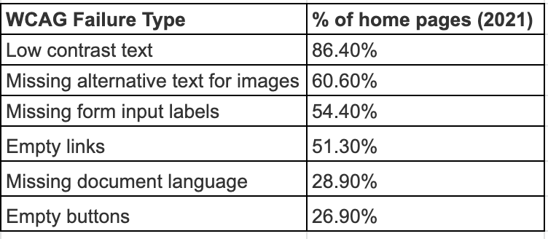
background
According to Web Content Accessibility Guidelines (WCAG), among the top-used 1,000,000 websites’ home pages, 96.7% of all errors detected fall into these six categories:
Notes:
Z:
Web Content Accessibility Guidelines, published by an main international standards organization for the Internet
In 2021, WebAIM, a web accessibility research institute, conducted an analysis on the top-used 1,000,000 websites’ home pages
96.7% of all errors detected fall into these six categories. Addressing just these few types of issues would significantly improve accessibility across the web.
Effect of the disabilities: 15%/5%

Slide 13
Why eye tracking for low vision?
Eye tracking demonstrates in real time what participants are looking at as they navigate an interface. It can uncover behaviors, strategies, and other mental processes that other usability methods may not have access to. Using eye tracking for low vision users highlights usability issues that may not affect the performance of people with normal vision.

Slide 14
Challenges
Notes:
M

Slide 15
General Guidelines for low-vision users friendly web
Limited budget, with only three participants
Strict timeline, with just a week to analyze experiment result
Have to set up and learn using Tobii Eye tracking software all by ourselves
Notes:
users can miss items-even those adjacent to each other-when the screen is magnified.

Slide 16
Methods
Notes:
M

Slide 17
Methods
REWRITE
WITH ARROwS AND BULLET POINTS

Slide 18
Participants
3 graduate students
Normal or corrected-to-normal vision
Within subjects
Design.
Two websites were tested
  Accessible​
  Inaccessible
Participants completed the same tasks in both website types
Participants looked through Chrome extension web disability simulator for both websites
Participants had access to Zoom magnifier for both sites
Equipment
Tobii eye tracker
Silketide Chrome extension
  20% blurred vision
  50% scotoma
NSW Government Website
Wix Website
Zoom (magnification software)
Recorder on iPhone
Notes:
M

Slide 19
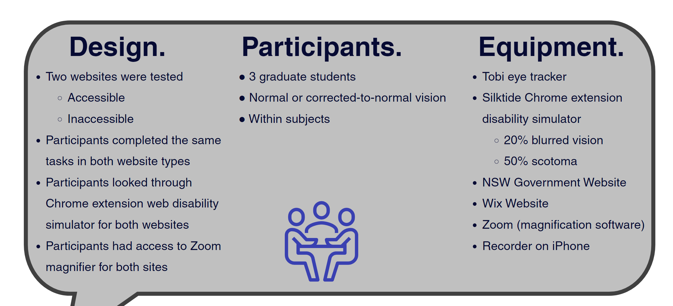

Slide 20
Within-subject experimental design
Why within-subjects experimental design?
this design controls more extraneous variables, as there can be large differences in eye movements between people performing the same task using the same interface,
reduces the cost and resources necessary to conduct these studies
Notes:
users can miss items-even those adjacent to each other-when the screen is magnified.

Slide 21
Differences Between Websites: three highlights
All of the information is the same. The way it is conveyed, however, is either accessible or inaccessible. Here I've highlighted some of the design differences between the accessible and inaccessible sites.

Slide 22
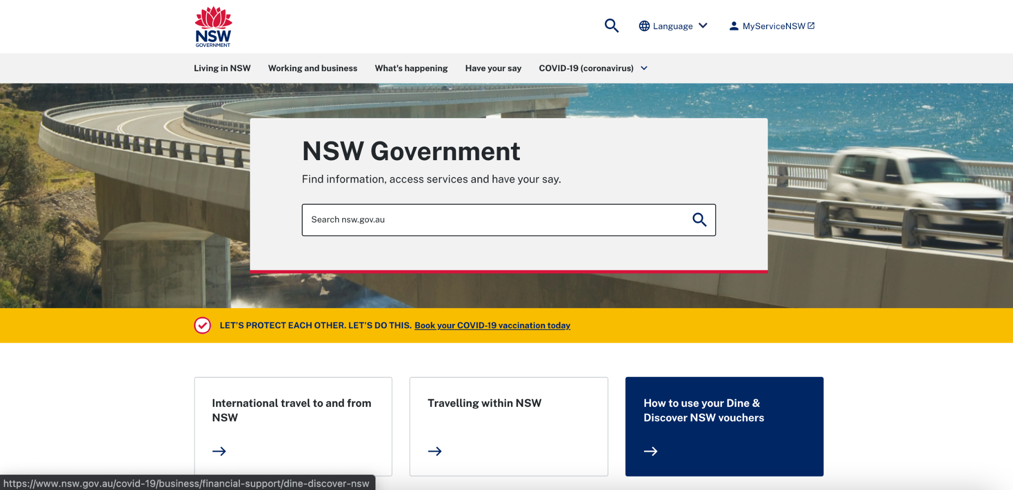
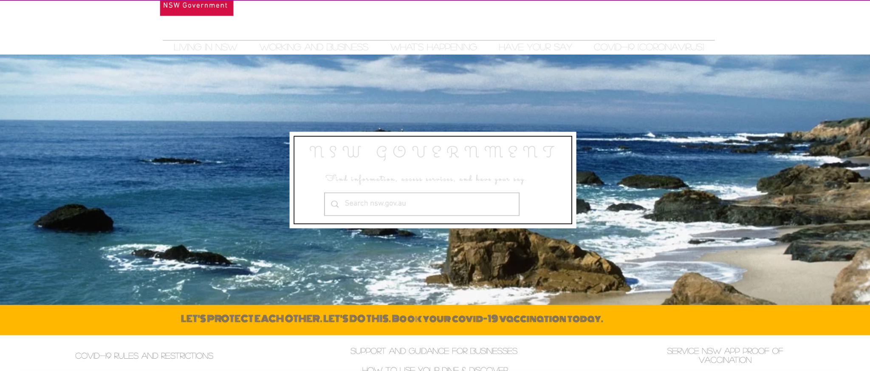
homepage
Accessible
Sufficient contrast, font, font size
Developed from WCAG guidelines
Multicolumn and row dropdown
Color of clickable areas changes when hovering
Inaccessible
Insufficient contrast
Includes inaccessible font
  Cursive
  All caps
Single column dropdown
Notes:
M: We chose these inaccessible features because they were chief complaints from users with low vision

Slide 23
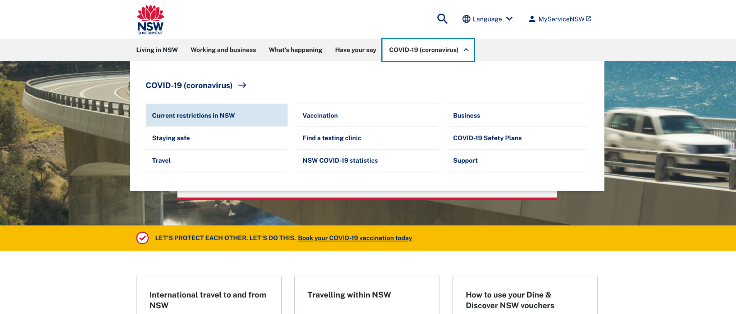
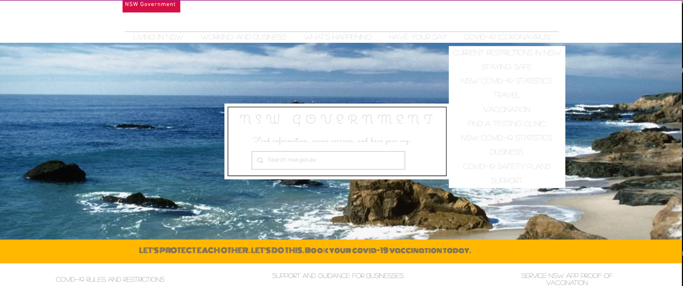
Accessible
Multicolumn and row dropdown
Hovered items change color
Tab headers highlighted when hovered over/selected
Single column dropdown
Hovered items do not change color
Tab headers stay the same when hovered over /selected
Inaccessible
Notes:
M

Slide 24
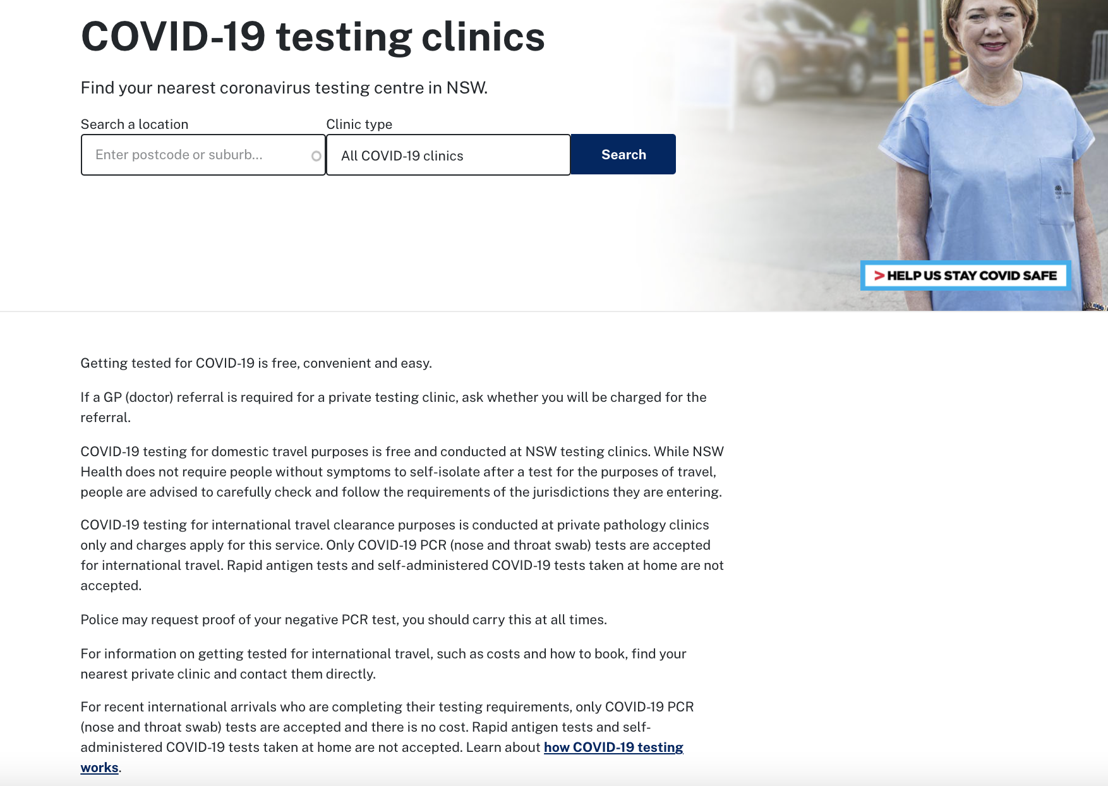
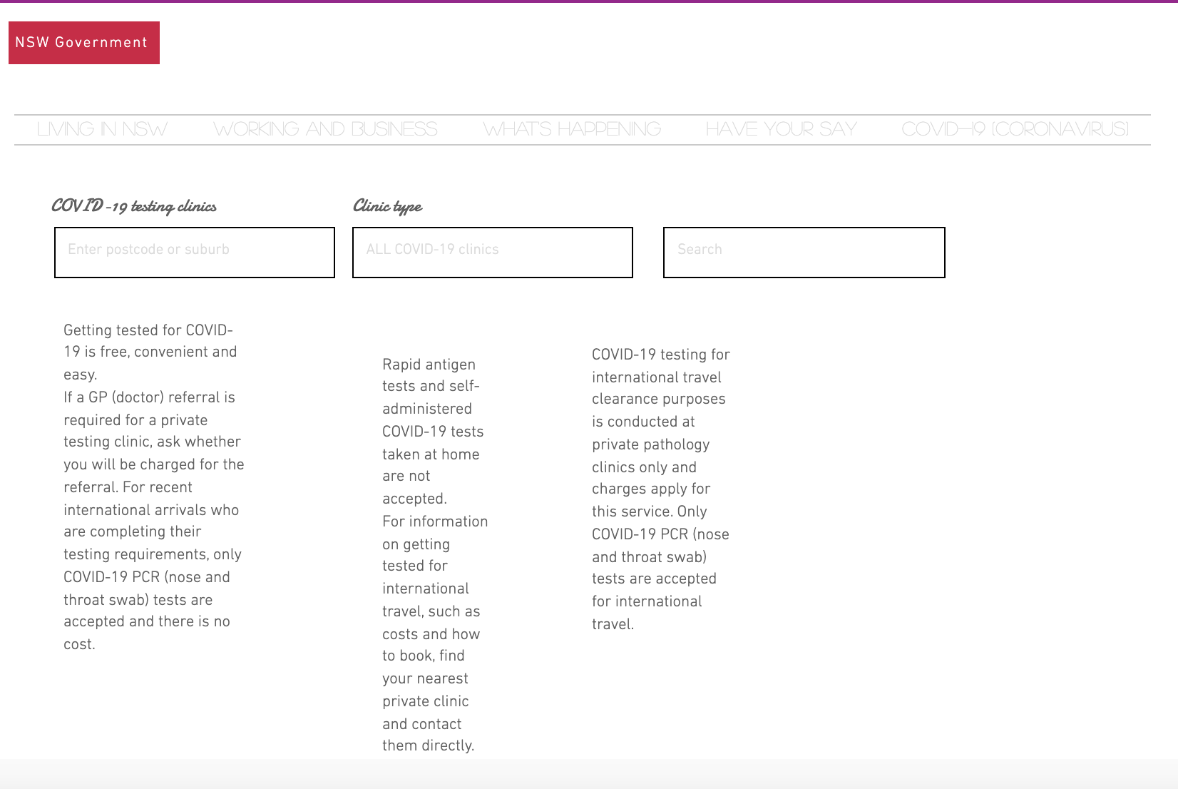
Accessible
Even single column
Easy to read in magnification lens
Inaccessible
Uneven/unnecessary columns
  Difficult to read using a magnification lens
Notes:
M

Slide 25
User testing: Think aloud
Tasks
Participants were instructed to complete three tasks for each website:
Find a place to get swabbed for COVID-19
Look up regulations about COVID-19 in the area
Find support for people with a disability in COVID-19
Participants then filled out a System Usability Scale (SUS) questionnaire for both sites
Notes:
M

Slide 26
Quantitative Analysis
Mean time to complete tasks (minutes)
Website Type | Task 1 (M) | Task 2 (M) | Task 3 (M) | TOTAL (M)
Accessible (A) | 00:38 | 00:44 | 00:43 | 2:06
Inaccessible (B) | 4:36 | 1:34 | 2:07 | 8:17
Although the t-test reveals that there was no significant difference between time differences in task completion rates due to the small sample size, there is a 6 minute mean difference between the accessible and inaccessible website.
A paired t-test revealed that these results are not statistically significant at the .05 level.
FIND T-TEST DATA
Notes:
Z

Slide 27
Task Completion Rates
All participants completed all three tasks in the accessible website condition
2/3 participants did not complete at least one task in the inaccessible condition
Notes:
Z

Slide 28
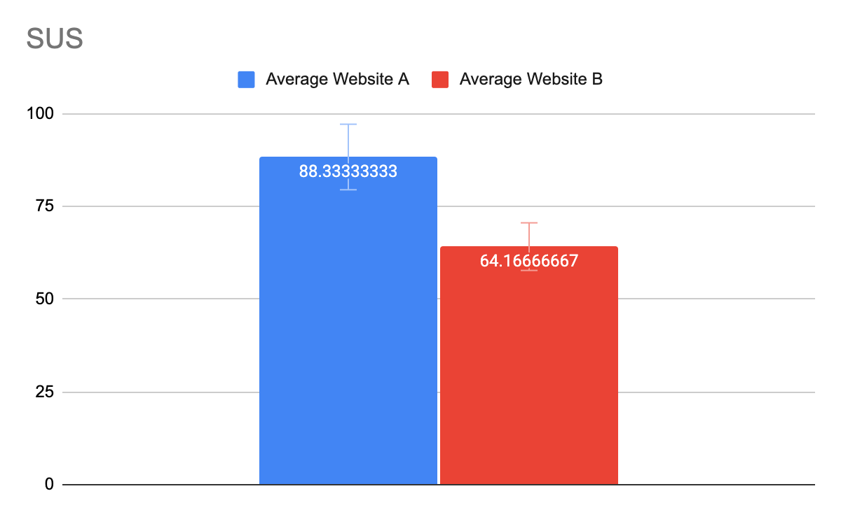
System Usability Scale
Industry Average = 68
COPY website
Notes:
Z

Slide 29
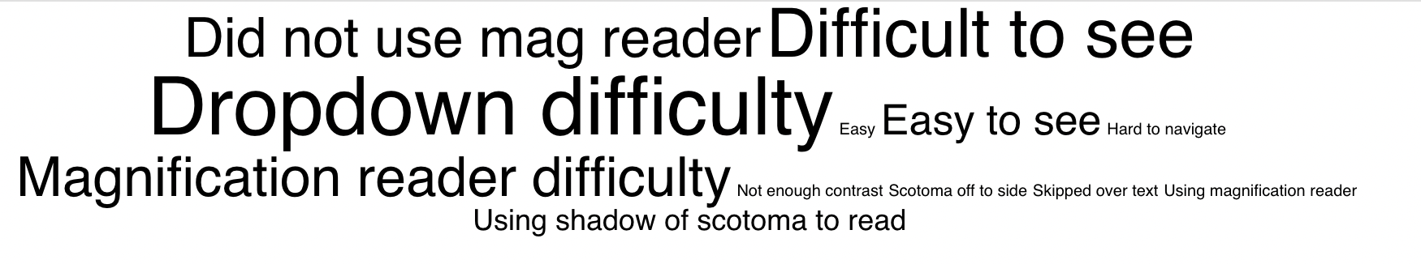
Qualitative Analysis
What participants said of most when thinking aloud?
Notes:
MTags from HyperResearch Qualitative Analysis Coding Tool

Slide 30

Qualitative Analysis: Reading Behavior
Accessible Site
Inaccessible Site
“Pretty easy”
“Clearer”
“ I’m using the shadow to see.”
I’m not sure what this is so I would definitely need the magnification for this part. Which really doesn’t help considering that it’s still really small”.
Notes:
M Differences in reading behavior

Slide 31
Under each video:
Quotes
Behavior & analysis

Slide 32
Qualitative Analysis: Dropdown Behavior
Accessible Site
Inaccessible Site
“Dropdown isn’t flying around everywhere.”
“Dropdown was the same color as the background”
Notes:
M

Slide 33
Under each video:
Quotes
Behavior & analysis

Slide 34
Qualitative Analysis: Inaccessible Site
All participants reported difficulty reading
  All developed strategies for reading and navigating
    Ex. Using the shadow of the scotoma or the magnification reader
  All remarked on the lack of sufficient contrast
All participants had difficulty with the dropdown
One participant actively used the magnification reader
All attempted to use the magnification reader
All reported difficulties with the magnification reader
Participants were mixed when they reported if they completed the task
Notes:
M

Slide 35
Qualitative Analysis: Accessible Site
All participants reported that site is easy to read
  Scotoma off to the side
  Did not use the magnification reader
All participants reported they thought they completed the task
Notes:
M

Slide 36
Top findings
1. Accessibility affects usability
6 minute average difference between accessible and inaccessible site to complete tasks
2. Dropdown formats
  Vision issues, especially scotomas, can hinder the effectiveness of dropdowns
  Multicolumn/multirow (the accessible) > single column (the inaccessible)
3. Avoid small graphics or fonts
  Not even magnification readers can clarify

Slide 37
To be Continued
Expand study to low vision users
More participants
Expand to other types of assistive technologies such as screen readers
Built out the Inaccessible website better
  Lack of clickable links confused participants
  Very limited clickable area
Research additional low vision technological needs
Use Eyelink eye tracker – able to store more data and create heat maps
Weblink software - able to select specific web pages
  Unable to select areas of Interest with Tobii system
Notes:
M

Slide 38
My learnings

